Slide 1
MRA project Presentation

Slide 2
Problem Statement:
An automobile parts manufacturing company has collected data of transactions for 3 years. They do not have any in-house data science team, thus they have hired you as their consultant. Your job is to use your magical data science skills to provide them with suitable insights about their data and their customers.
Data Dictionary:
ORDERNUMBER : | Order Number | CUSTOMERNAME : | customer
QUANTITYORDERED : | Quantity ordered | PHONE : | Phone of the customer
PRICEEACH : | Price of Each item | ADDRESSLINE1 : | Address of customer
ORDERLINENUMBER : | order line | CITY : | City of customer
SALES : | Sales amount | POSTALCODE : | Postal Code of customer
ORDERDATE : | Order Date | COUNTRY : | Country customer
DAYS_SINCE_LASTORDER : | Days_ Since_Lastorder | CONTACTLASTNAME : | Contact person customer
STATUS : | Status of order like Shipped or not | CONTACTFIRSTNAME : | Contact person customer
PRODUCTLINE : | Product line – CATEGORY | DEALSIZE : | Size of the deal based on Quantity and Item Price
MSRP : | Manufacturer's Suggested Retail Price

Slide 3
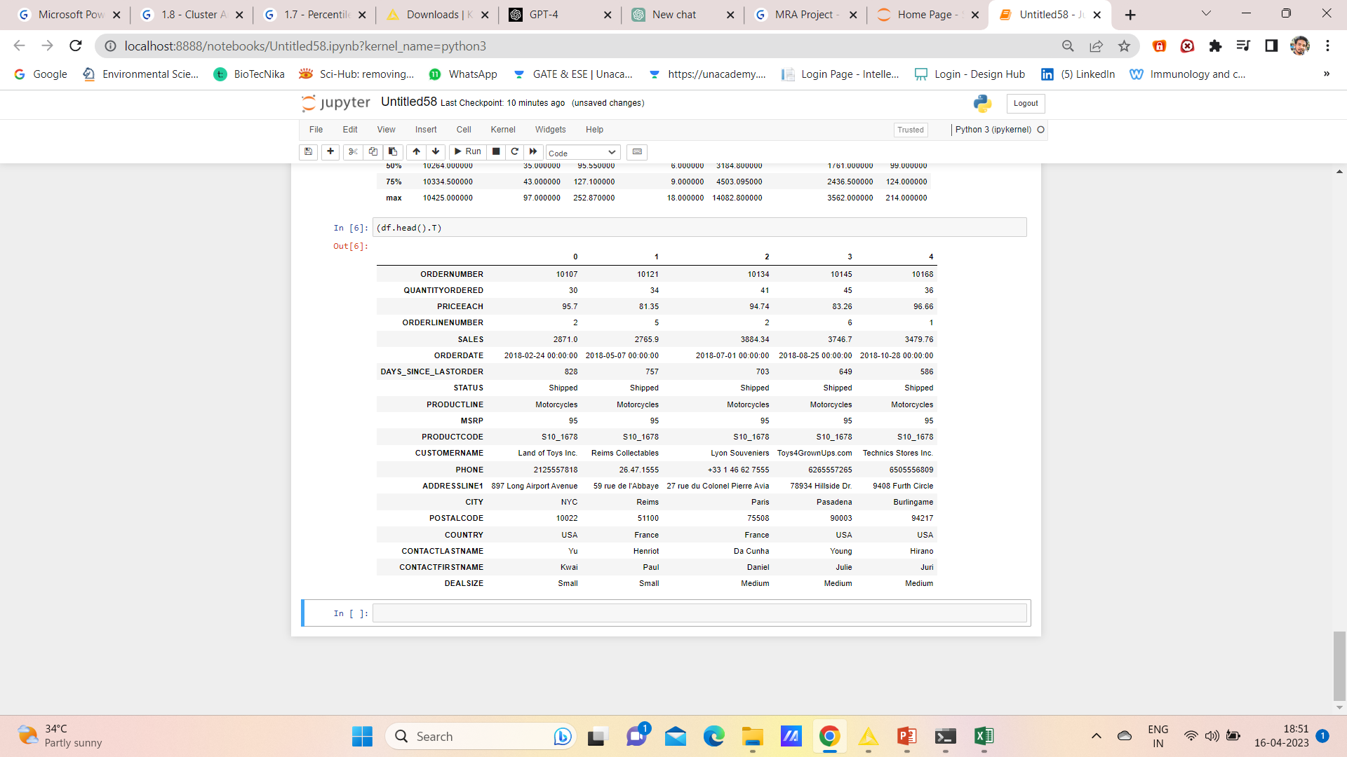
Agenda & Executive Summary of the data
Shape of the data: (2747, 20)
First 5 rows of the data

Slide 4
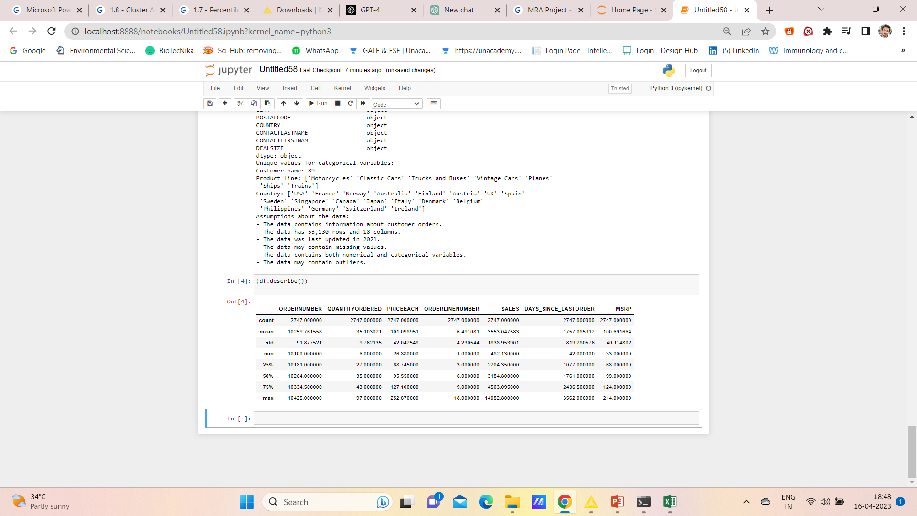
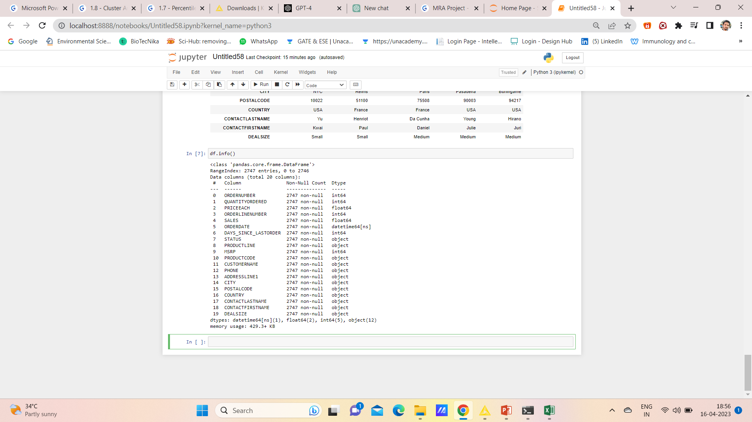
Summary statistics of the data
INFo of the data

Slide 5
The dataset has 20 columns and 2747 entries (rows)
Most of the columns are of object type, except for ORDERNUMBER, QUANTITYORDERED, PRICEEACH, ORDERLINENUMBER, SALES, MSRP, and DAYS_SINCE_LASTORDER which are of int64 and float64 types.
The ORDERDATE column is of datetime64[ns] type, which means it is a date type column.
There are no null values in the dataset.
Based on these summary stats, we can assume that there might be some outliers in the dataset as there is a significant difference between the minimum and maximum values for some columns, such as the sales amount. We can also assume that there might be some correlation between the quantity ordered and the sales amount, as well as between the price per item and the sales amount.

Slide 6
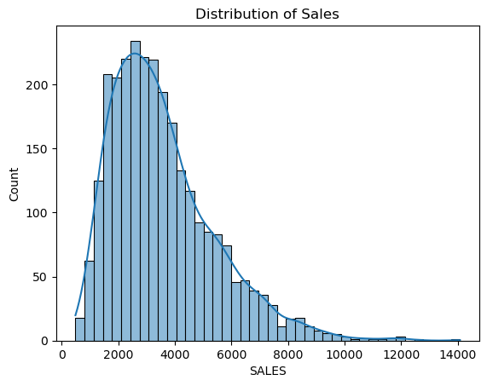
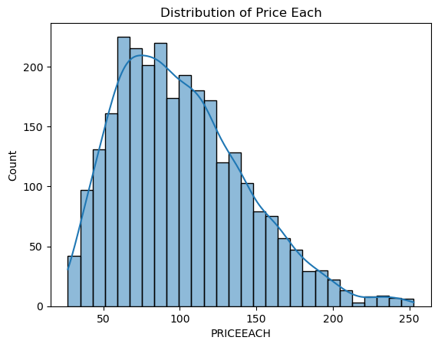
Exploratory Analysis and Inferences
1. Univariate analysis
For the Distribution of the sales, we can see that most of the amount of sales is between 2000-4000
Distribution of price Follows almost equal normal distribution, as still most of the price is between 60-120

Slide 7
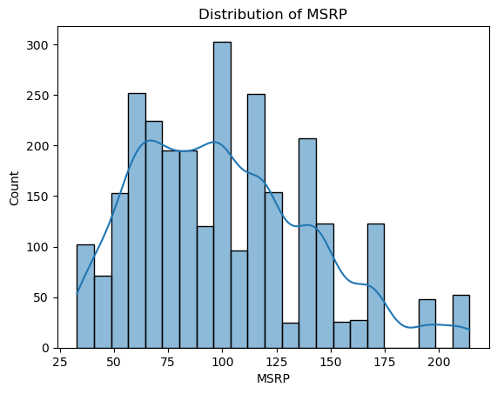
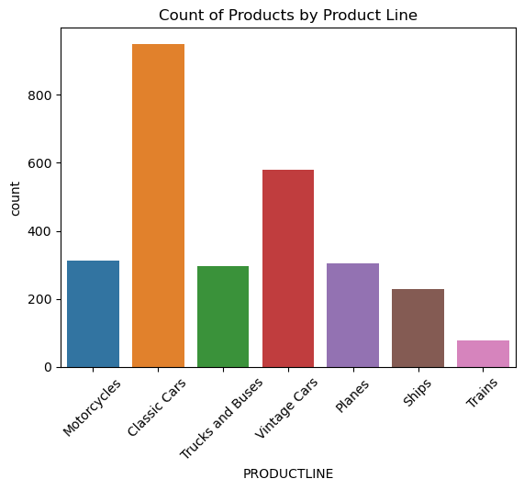
Distribution of Manufacturer's Suggested Retail Price follows multimodal nature.
In count of products by product line we can see that maximum count is of classic cars followed by vintage cars

Slide 8
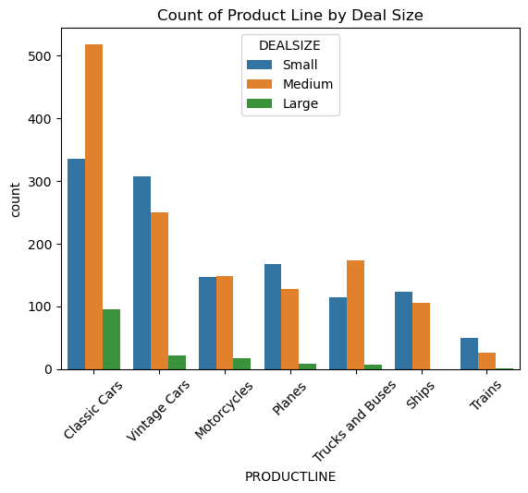
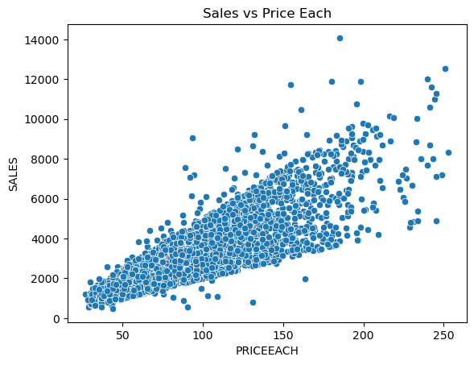
Bivariate analysis
We can see that sales vs price increases exponentially as there is a positive correlation in the data, which means as the sales increases price of the cars also increases simultaneously.
We can also see that count of medium>small>large size classic cars is maximum followed by vintage and motorcycles.

Slide 9
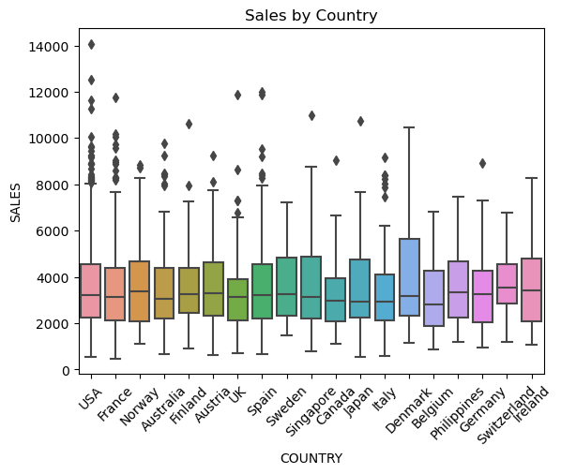
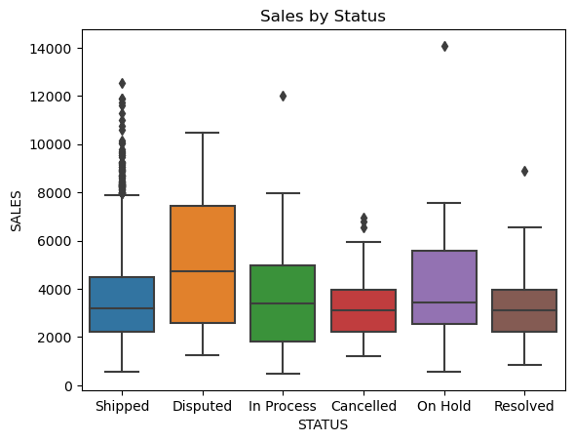
We can see that Average sales across the country is between 2000-4000 units, also we can see that Denmark has maximum number of sales which is then followed by Sweden.
We can also see that Disputed status has maximum number of sales followed by On Hold.

Slide 10
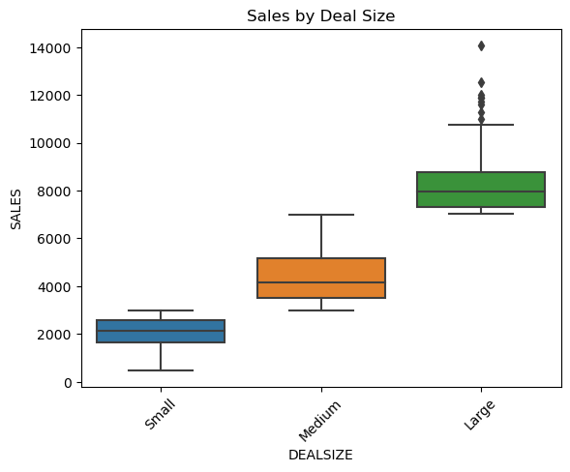
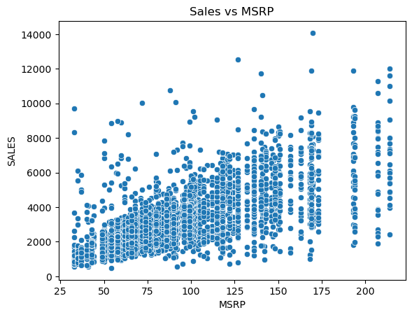
We can see that there is large vehicle deal size followed by medium with the amount of sales.
We can aslo there is increasing trend in MSRP with the amount of sales.

Slide 11
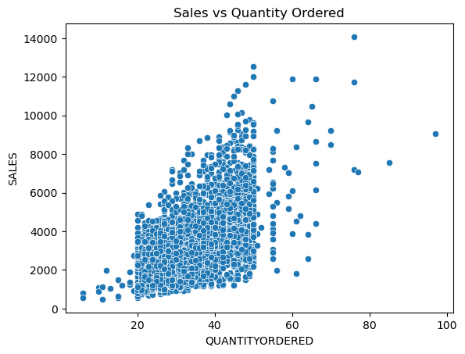
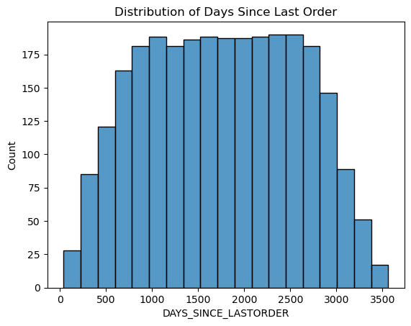
As we can see that most of the quantity ordered is between 20-45 with the amount of sales we compare.
Also when we see the distribution of the days from last order most of the order is ordered between 1000-3000 days.

Slide 12
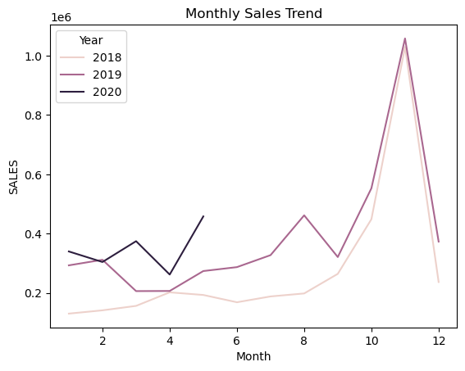
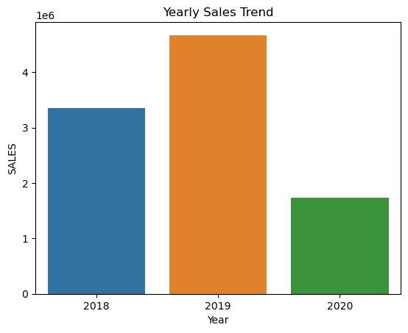
Sales trend across monthly and early
We can see that For monthly sales there is maximum number of sales is of 11th month for 2018 and 2019 year, and for 2020 year last sale month is of 5th month.
Also as compared to 3 years highest number of sales happened in the year 2019 followed by 2018 and the least number of sales happened in 2020.

Slide 13
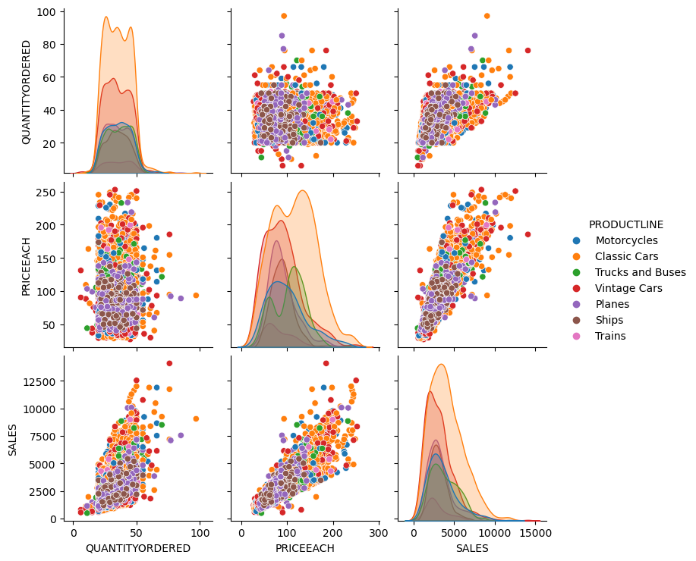
Multivariate Analysis
As we can see that quantity ordered and each price with sales shows positive correlation.
Also we can see that classic cars have have maximum sales compared to other cars

Slide 14
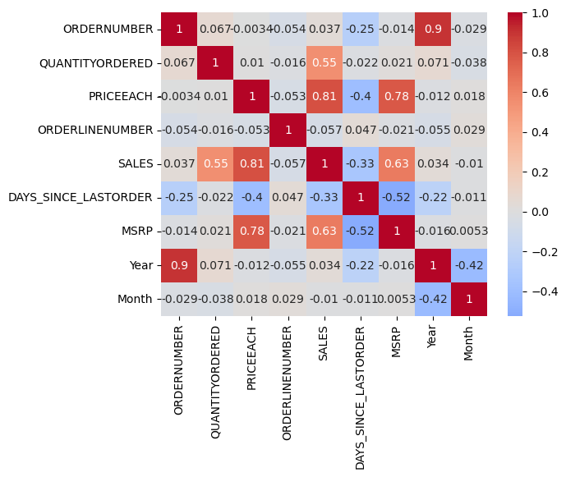
Heat Map
From above heat map there is some good correlation of year and order number, sales and price each and MSRP and price each

Slide 15
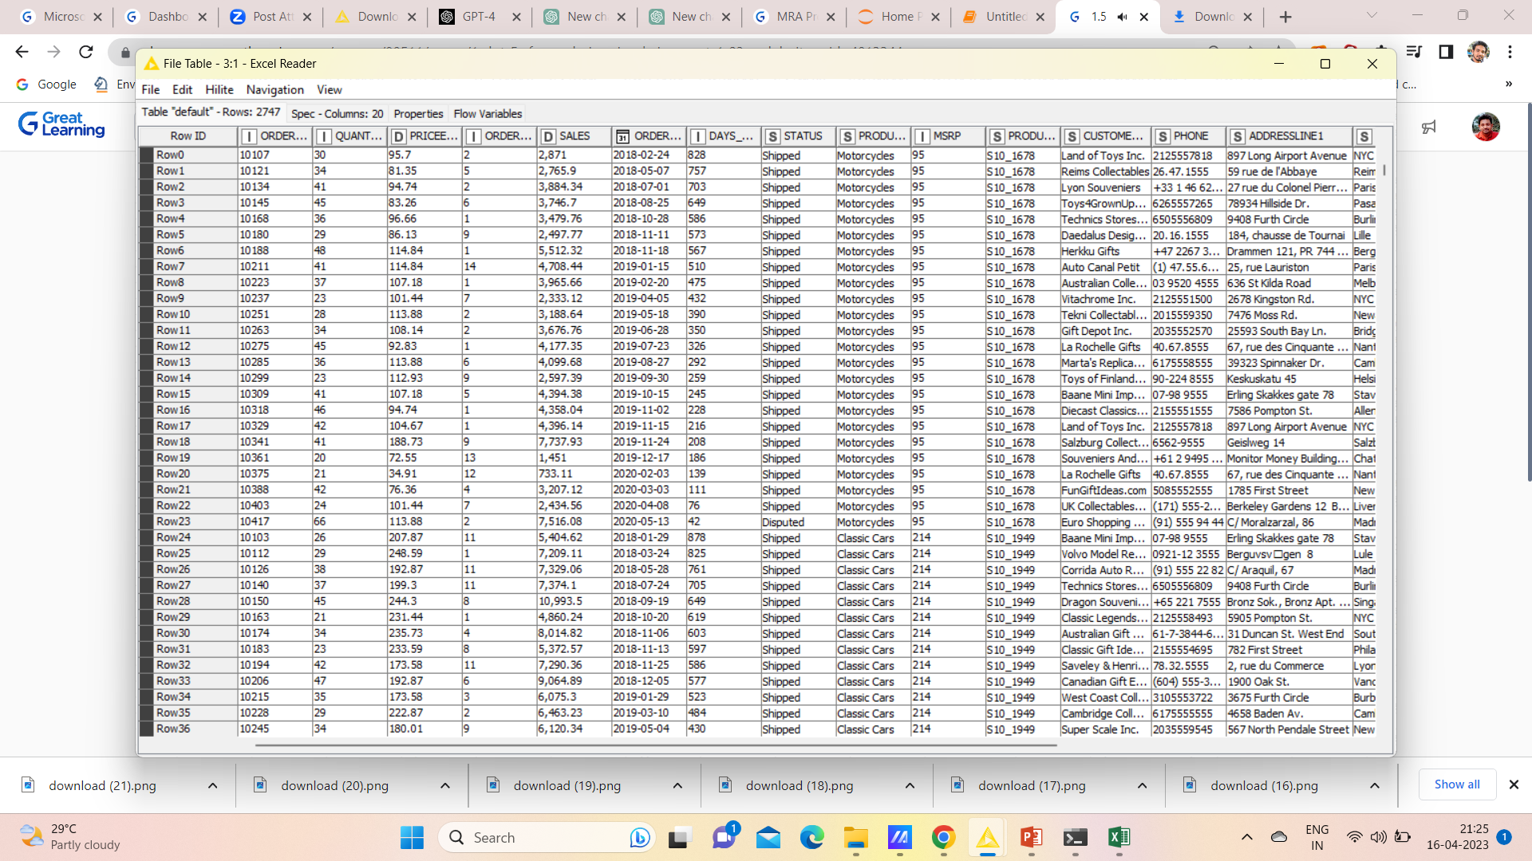
Customer Segmentation using RFM analysis (4 segments) -> What is RFM? -> What all parameters used and assumptions made? -> Showcase the KNIME workflow image -> What results are there in the output table head?
RFM analysis is a customer segmentation technique that helps to identify groups of customers based on their purchasing behavior. RFM stands for Recency, Frequency, and Monetary Value.
Recency: How recently did the customer make a purchase?
Frequency: How often does the customer make purchases?
Monetary Value: How much does the customer spend on each purchase?
Tool used- KNIME (output table)

Slide 16
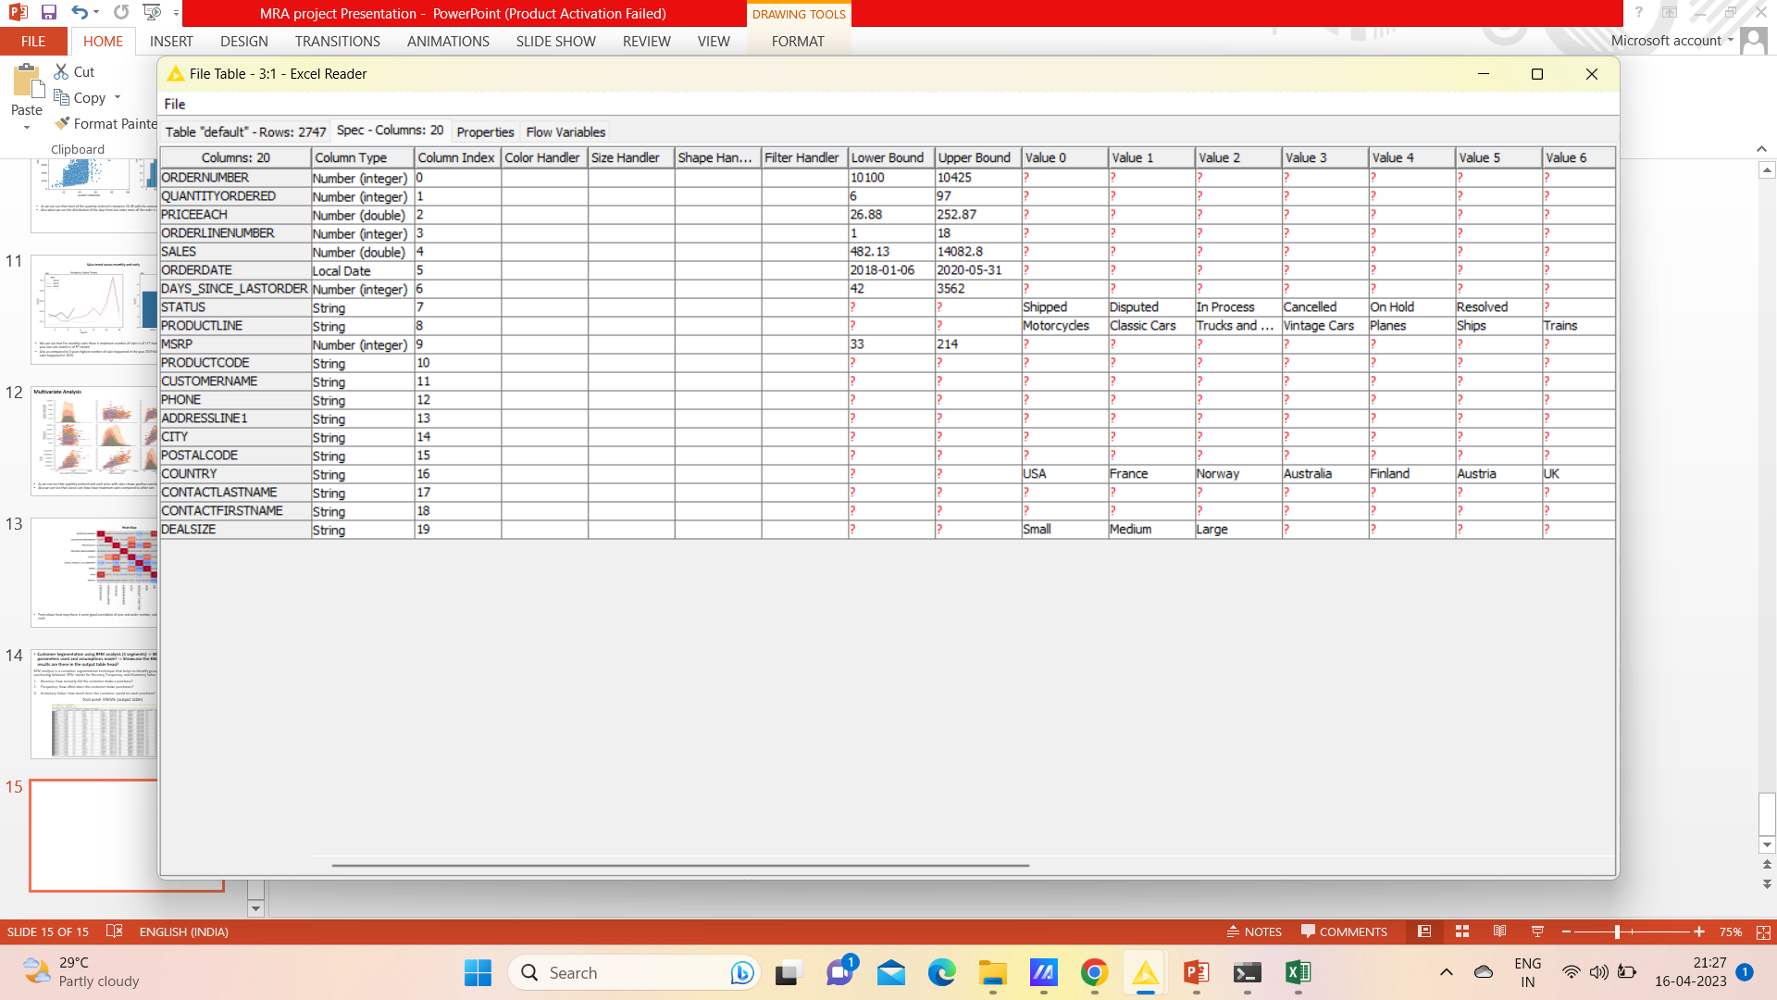

Slide 17
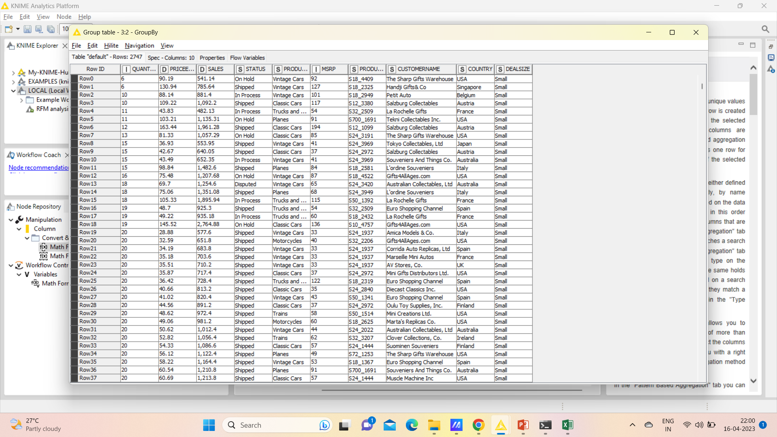
Imported the data in to the KNIME
Grouped the data according to price, sales, status, production, customer name, MSRP, Country and Deal size.

Slide 18
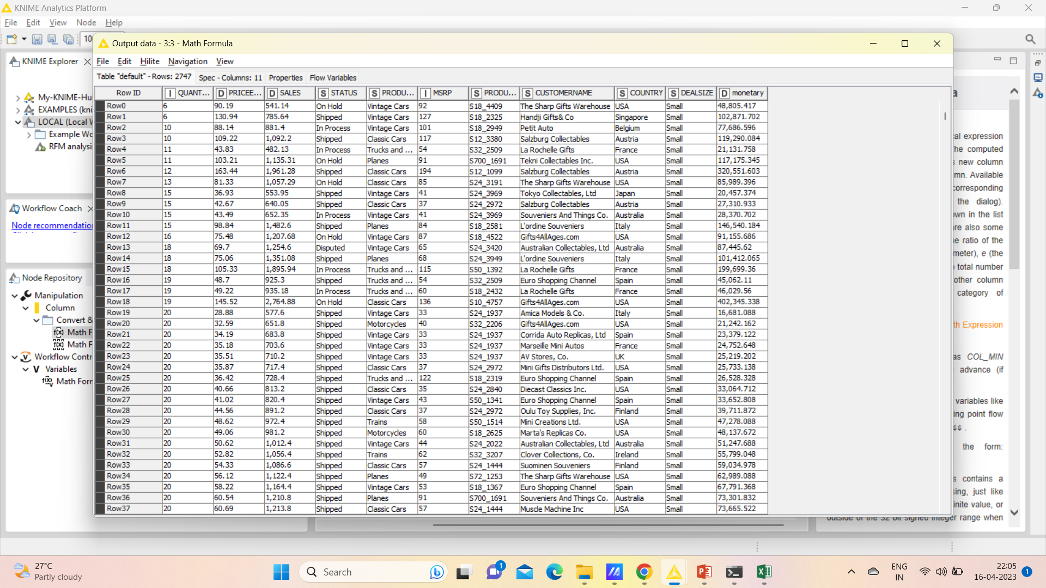
Calculated the Monetary Value by (price each*sales)

Slide 19
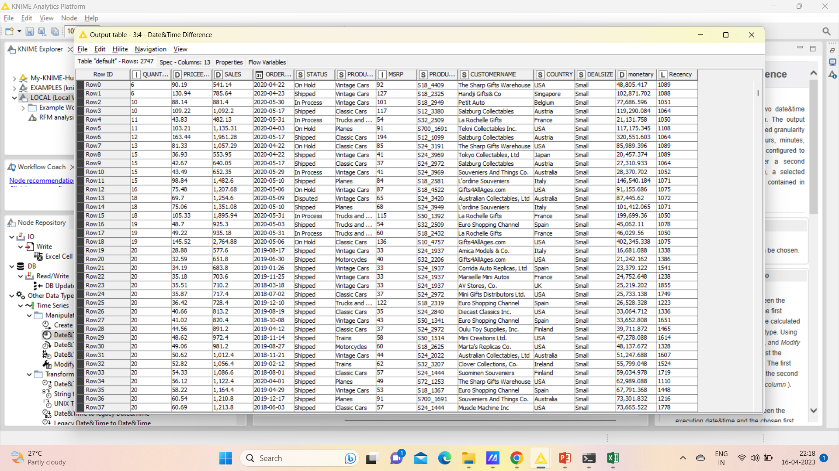
Calculated the Recency with the difference of order date with current date

Slide 20
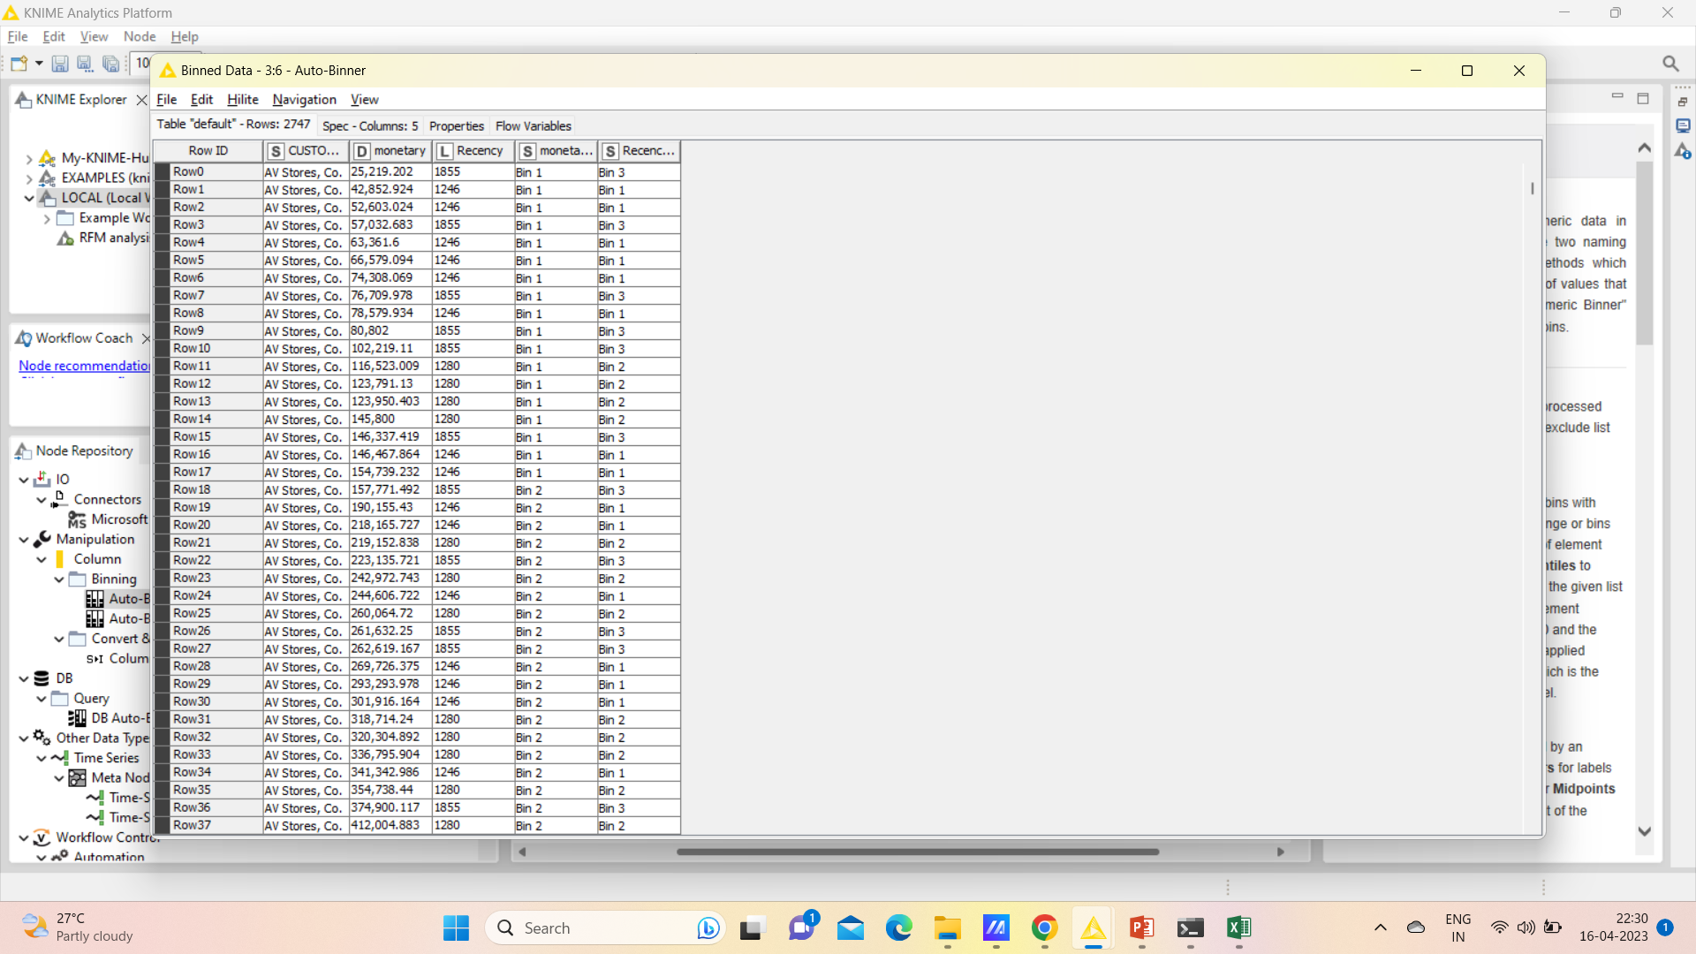
Assigning scores to customers based on their recency, frequency, and monetary value

Slide 21
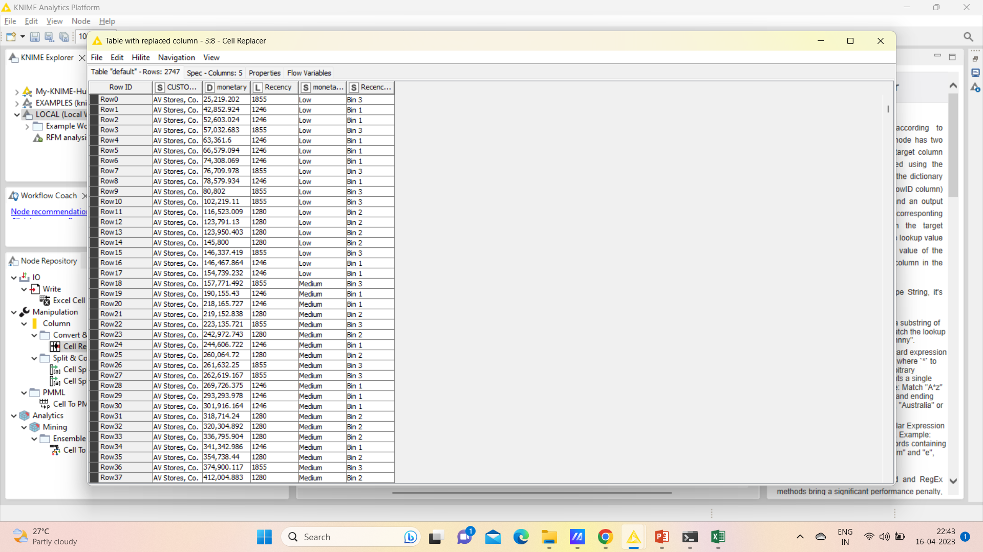
Segmented Bin 1, Bin 2 and Bin 3 as High, medium and low by having the following output as

Slide 22
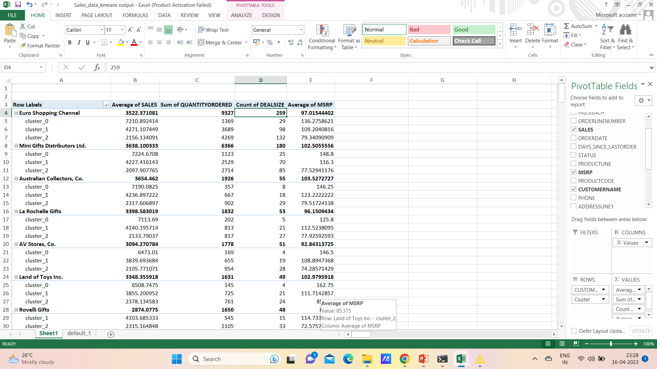
Inferences from RFM Analysis and identified segments -> Who are your best customers? (give at least 5) -> Which customers are on the verge of churning? (give at least 5) -> Who are your lost customers? (give at least 5) -> Who are your loyal customers? (give at least 5)
Top 5 Best customers are
Euro shopping Channel
Mini Gifts Distributions ltd
Australian collectors, Co
La Rochelle Gifts
AV Stores, Co.

Slide 23
Thank You

